Slide 1
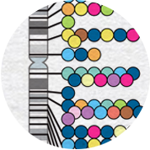
Genome-wide association studies
September 30, 2022 | CMDB Quantitative Biology Lab

Slide 2
GWAS test for associations between genotype and phenotype

Slide 3
GWAS are just a lot of linear regression
…repeat for all genotyped variants.

Slide 4
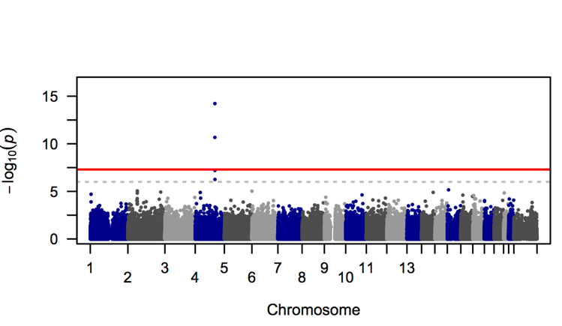
Manhattan plots depict associations at all tested markers

Slide 5
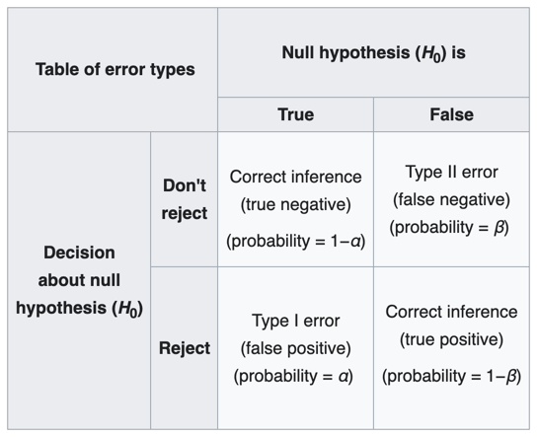
Different types of errors
Notes:
This table is useful for conceptualizing different outcomes of a hypothesis test. The top left and bottom right portions of this 2 x 2 grid are what we generally strive for in our experiments--to reject the null hypothesis when the null hypothesis is false, but not when the null hypothesis is true. Meanwhile, if we fail to reject the null hypothesis when the null hypothesis is false, we call this a false negative, or type II error.
In contrast, if we reject the null hypothesis when the null hypothesis is true, we call this a false positive or type I error. Alpha is defined as the probability of type I error (false positive).
When conducting hypothesis testing, we often want to control the level of alpha. When we conduct a single statistical test, we often want to ask if our p-value is smaller than an alpha of 0.05. Of course, this is arbitrary, and we can choose an alpha that is appropriate for our problem.

Slide 6
Different types of errors
Notes:
This table is useful for conceptualizing different outcomes of a hypothesis test. The top left and bottom right portions of this 2 x 2 grid are what we generally strive for in our experiments--to reject the null hypothesis when the null hypothesis is false, but not when the null hypothesis is true.

Slide 7
Different types of errors
Notes:
Meanwhile, if we fail to reject the null hypothesis when the null hypothesis is false, we call this a false negative, or type II error.

Slide 8
Different types of errors
Notes:
In contrast, if we reject the null hypothesis when the null hypothesis is true, we call this a false positive or type I error. Alpha is defined as the probability of type I error (false positive).
When conducting hypothesis testing, we often want to control the level of alpha. When we conduct a single statistical test, we often want to ask if our p-value is smaller than an alpha of 0.05. Of course, this is arbitrary, and we can choose an alpha that is appropriate for our problem.

Slide 9
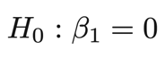
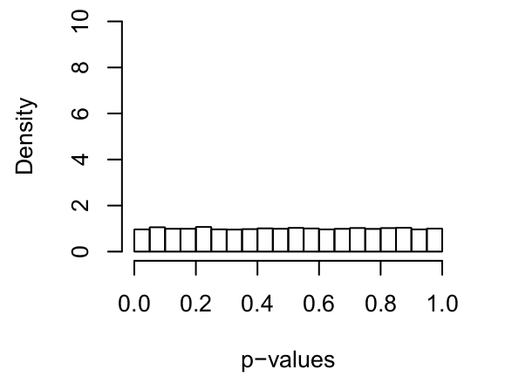
Many tests, many errors
Notes:
Even for data generated under the null hypothesis, we expect a uniform distribution of p-values. So for a million statistical tests, you should expect alpha (0.05) times 1M = 50,000 significant hits just by chance.

Slide 10
Controlling the family-wise error rate
The family-wise error rate (FWER) is the probability of making any Type 1 errors at all.
Examples of FWER correction include Bonferroni correction:
Test each hypothesis at a level α / m, where m is the number of hypothesis tests and α is the desired probability of making any Type 1 errors.
Notes:
There are two basic approaches to controlling the rate of Type I error in the context of multiple testing. The first attempts to control the family-wise error rate, or the probability of making ANY type I errors at all.
An example of FWER correction that you may have heard of is Bonferroni correction. To apply a bonferroni correction, you simply test each hypothesis at a level of alpha / m, where m is the number of hypotheses and alpha is the desired level of type I errors.

Slide 11
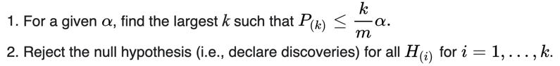
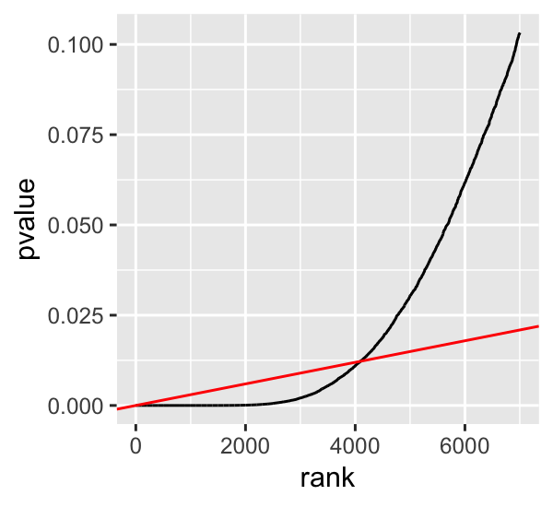
Controlling the false discovery rate
The false discovery rate (FDR) is the expected proportion of Type 1 errors out of all rejections of the null hypothesis. Examples of FDR correction include the Benjamini-Hochberg procedure. Test k hypotheses and obtain p-values.
ordered p-values
slope = α / m
Notes:
The second basic approach to addressing type I errors during multiple testing is by controlling what is called the false discovery rate. The false discovery rate is the expected proportion of type I errors out of all of the rejections the null hypothesis. So if alpha is 0.05, we are saying that we will allow up to 5% false positives among the test we call significant.
A common approach to FDR correction is the Benjamini-Hochberg procedure. We won’t go over it in detail this afternoon, but the basic algorithm is described here and may be covered later in quant lab.

Slide 12
QQ plots visualize the distribution of p-values

Slide 13
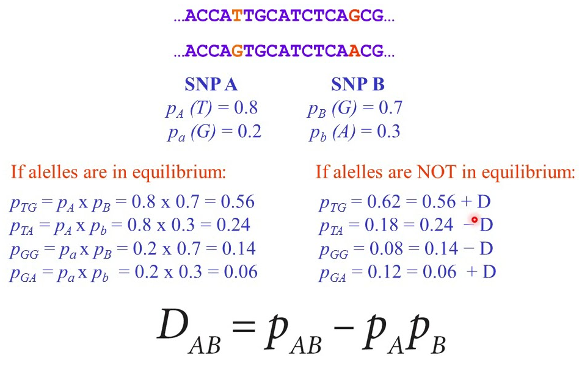
Linkage disequilibrium is the correlation of alleles at different markers

Slide 14
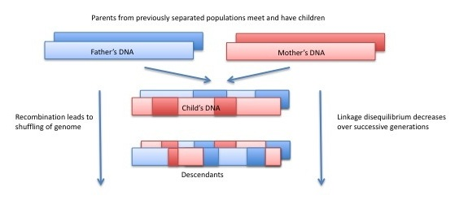
Alleles in linkage disequilibrium define “haplotypes”

Slide 15
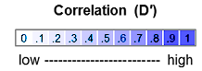
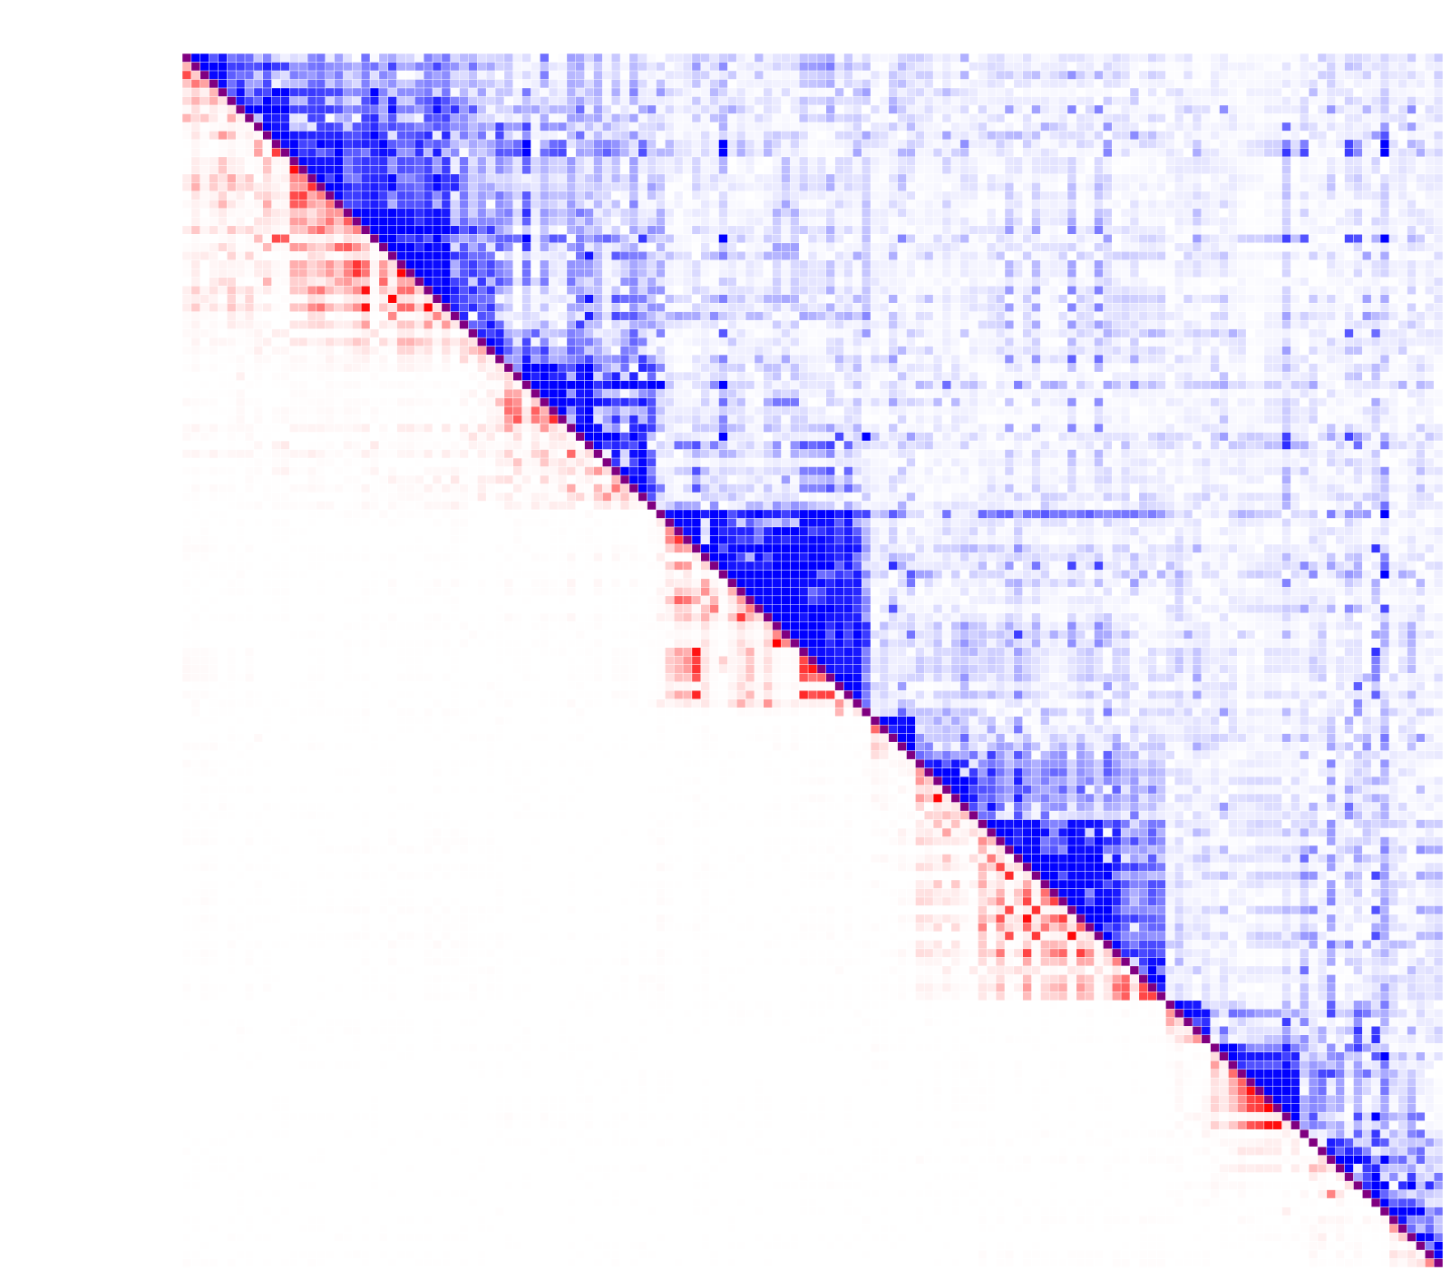
Alleles in linkage disequilibrium define “haplotypes”
Position on chromosome
Position on Chromosome
Position on chromosome
Machiela, M. J., Chanock, S. J. Bioinformatics, 31, 3555-3557 (2015).
Machiela, M. J., Chanock, S. J. Bioinformatics, 31, 3555-3557 (2015).
Notes:
Extends over hundreds of Kb

Slide 16
GWAS depends on linkage disequilibrium

Slide 17
More information than meets the eye
Notes:
Talk about the implications of imputation.
Genotyping arrays can be lower density and still capture most common variation by proxy.
Low coverage sequencing can be a very effective approach to GWAS design.

Slide 18
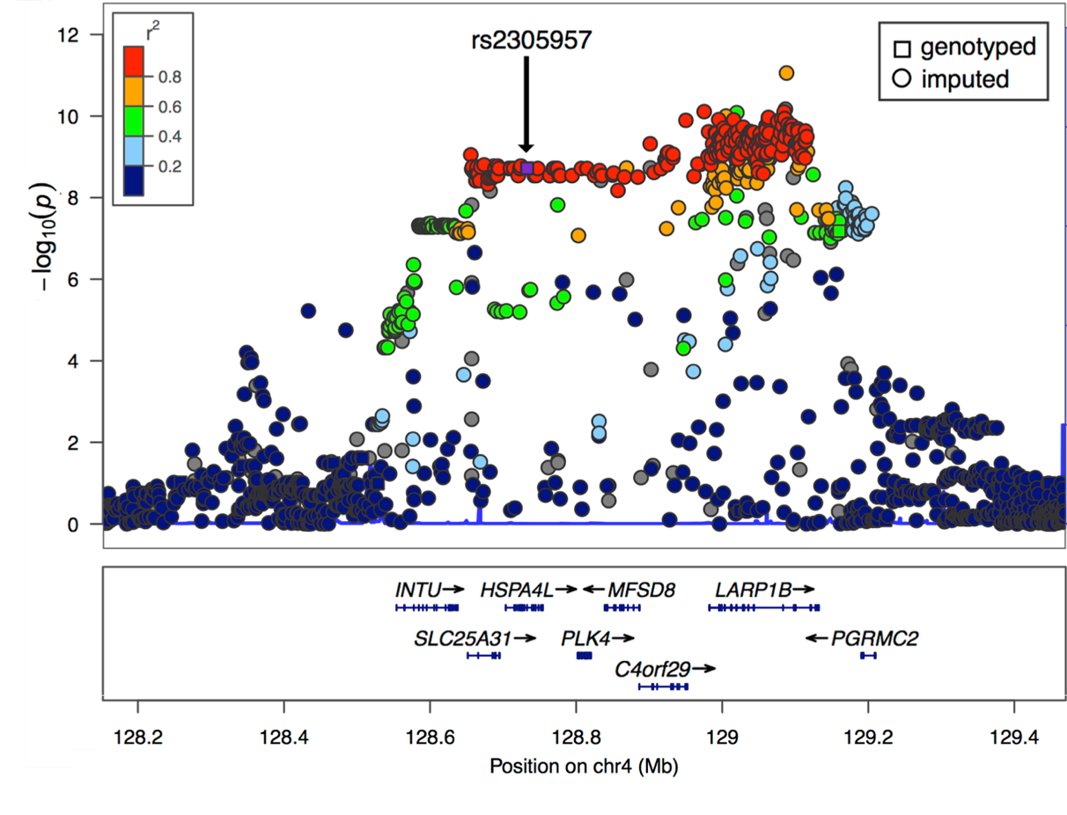

Slide 19
More samples, more (and smaller-effect) associations

Slide 20
http://big.stats.ox.ac.uk/ https://ldlink.nci.nih.gov/?tab=ldproxy https://popgen.uchicago.edu/ggv/

